Slide 1
Comparative Analysis of Machine Learning Models in Predicting Stock Returns
James Mortensen

Slide 2
Agenda
Overview
Previous Work
Experiment Design
Results
Conclusion
Future Work

Slide 3
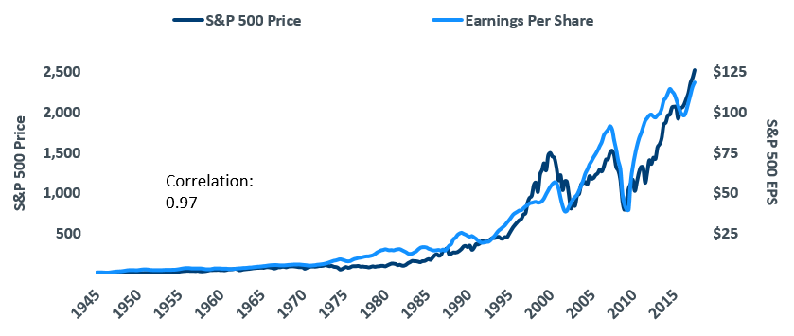
Overview
Known Correlation between earnings and share price
Goal: Find untapped value in the S&P 500 Index – Predict 5 year returns of Individual Stocks
Stocks with a high potential to go up based on earnings increases
Personal Interests
https://www.calamos.com/blogs/voices/jpc-why-the-bull-market-can-continue/

Slide 4
Previous Work
Y. Huang, S. Nakamori, and S.-Y. Wang, "Forecasting stock market movement direction with support vector machine," Computers & Operations Research, vol. 32, no. 10, pp. 2513-2522, 2005.
Predict stock market direction in Hong Kong and Korean Markets with factors including S&P 500 index and Exchange Rates from 2001-2011
P. C. Tetlock, "Giving Content to Investor Sentiment: The Role of Media in the Stock Market," The Journal of Finance, vol. 62, no. 3, pp. 1139-1168, 2007.
Explores social media and stock market activity interaction
Pessimism Factor – Trading on social media sentiment alone
Notes:
Y. Huang, S. Nakamori, and S.-Y. Wang, "Forecasting stock market movement direction with support vector machine," Computers & Operations Research, vol. 32, no. 10, pp. 2513-2522, 2005.
Able to do this with individual stocks and indices HSI and KOSPI
Verified that international markets have co-movement and correlation to each other
P. C. Tetlock, "Giving Content to Investor Sentiment: The Role of Media in the Stock Market," The Journal of Finance, vol. 62, no. 3, pp. 1139-1168, 2007.
High values of media pessimism induce downward pressure on market prices; and unusually high or low values of pessimism lead to temporarily high market trading volume.
Further-more, the price impact of pessimism appears especially large and slow to reverse itself in small stocks.
it is possible to construct a hypothetical zero-cost trading strategy using Negative words that yields non-trivial excess returns–7.3% per year–with little risk – High Portfolio turnover – Commission

Slide 5
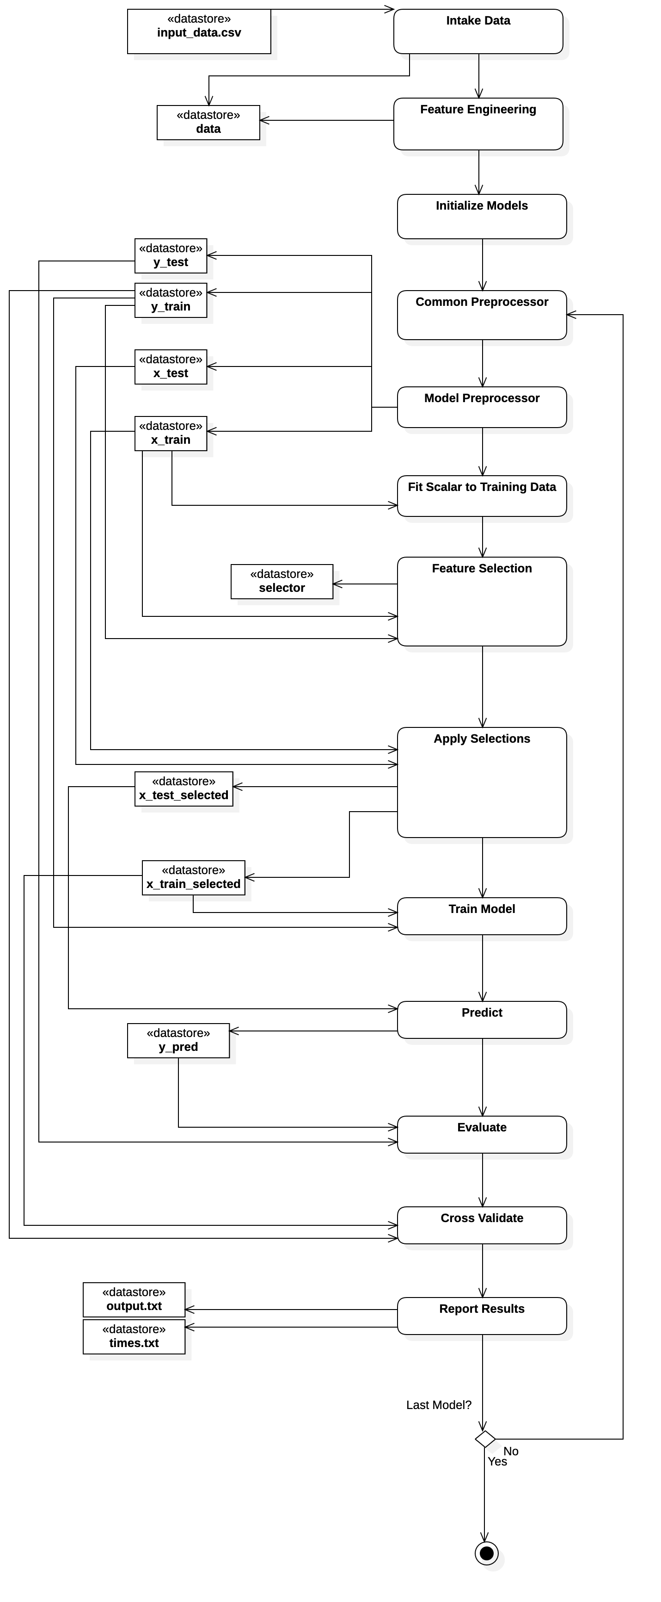
Experiment Design
Data Collection Not Reflected In Diagram
Data is split, Models are fit and trained
Prediction, Evaluation, Cross Validation
Output to Results Files

Slide 6
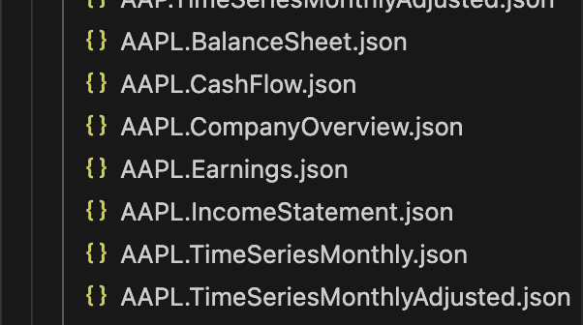
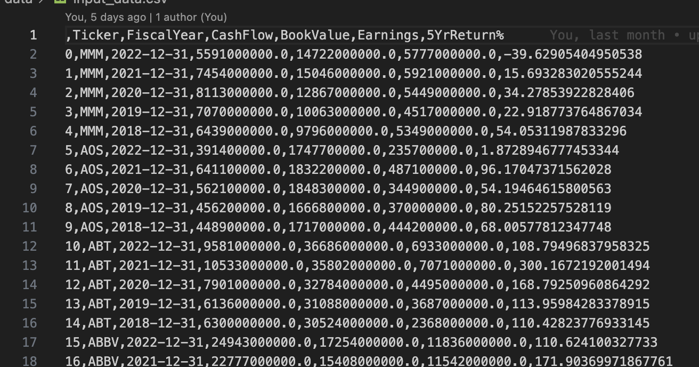
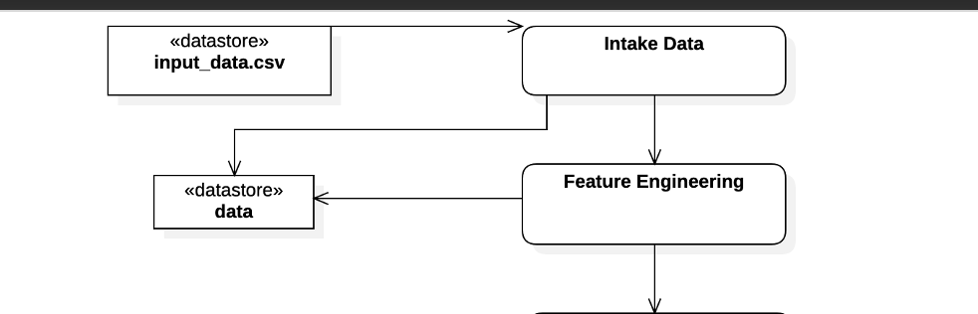
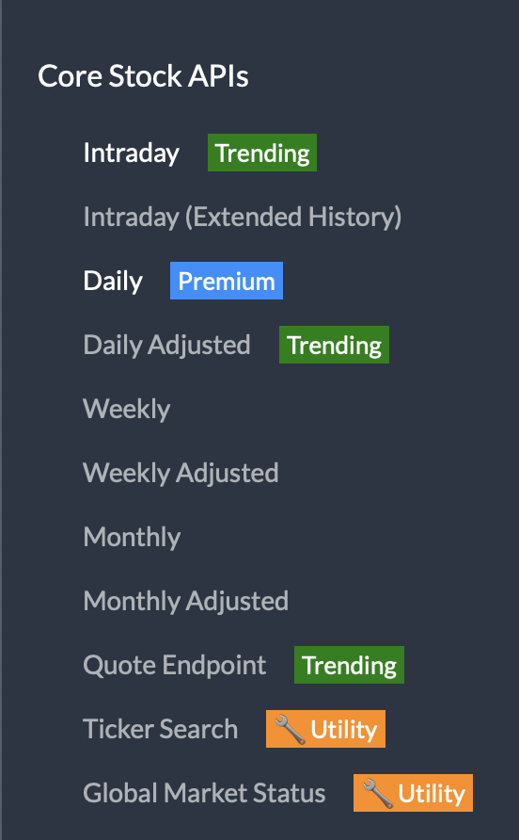

Data Collection
Alpha Vantage API
Collect JSON files for S&P 500
Convert to a CSV input to the experiment

Slide 7
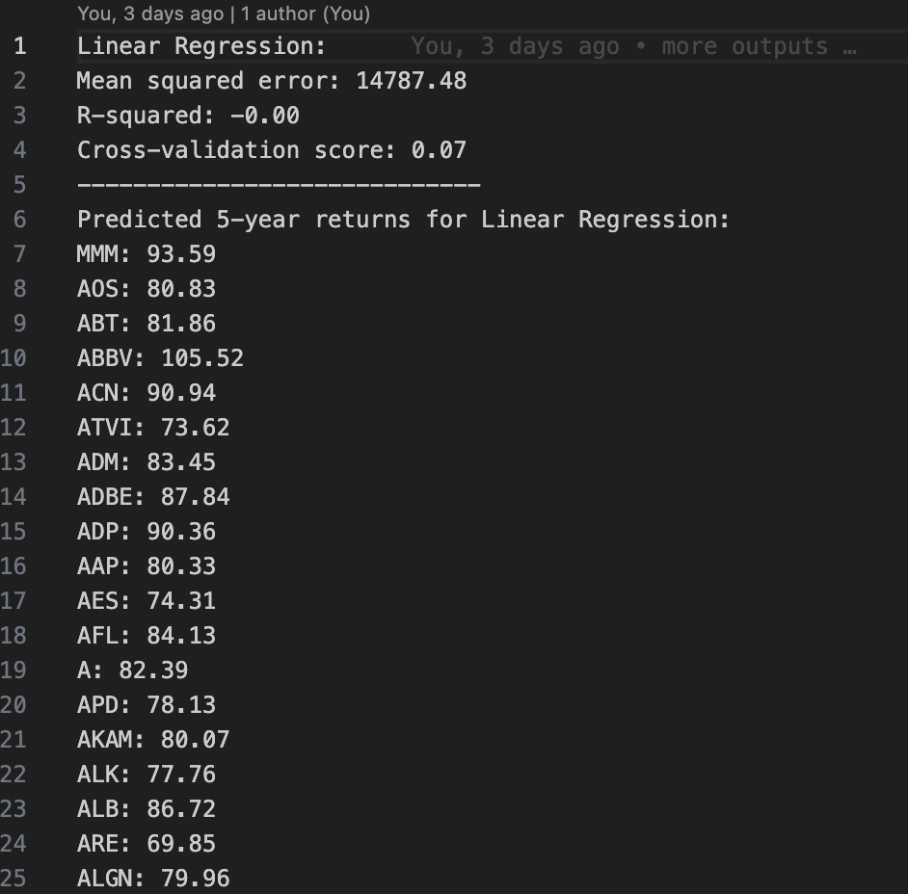
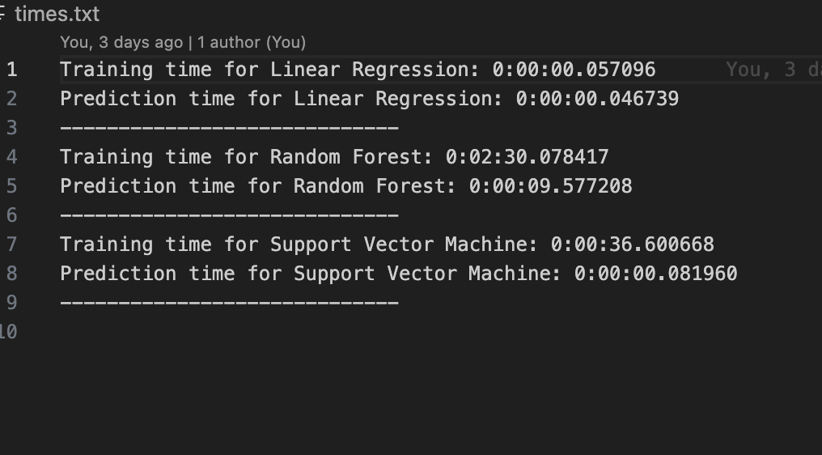
Experiment Outputs
Output.txt
Times.txt

Slide 8
Results
Model | Mean squared error | R-squared | Cross-validation score
Linear Regression: | 8857.39 | -0.01 | 0.02
Random Forest: | 7964.94 | 0.09 | 0.12
Support Vector Machine: | 8750.26 | 0.01 | 0.09
High Mean Squared Errors
R-Squared Very low for each model
Cross-Validation scores were low
Model | Training Time | Predicition Time
Linear Regression | 0:00:00.057096 | 0:00:00.046739
Random Forest | 0:02:30.078417 | 0:00:09.577208
Support Vector Machine | 0:00:36.600668 | 0:00:00.081960

Slide 9
Conclusions
This methodology did not accomplish the expected result of predicting 5-year stock returns with high accuracy.
All three models were under-fitted to the data
Cross validation scores showed that none of the 3 models performed well.
Feature engineering, variable selection, and data normalization are very important.
Financial markets are complex and unpredictable
Macroeconomic indicators, market sentiment, nor geopolitical events were considered

Slide 10
Future Work
Data Enhancement
Data Imputation
Model Selection: Neural Networks, RNN’s, LTSM Networks
Better Hyperparameter Tuning
Hybrid Models
Notes:
Data Enhancement
- Further enrich the data with expanded historical range (longer-term trends)
- additional variables: market sentiment data, industry-specific indicators, and macroeconomic variables, such as GDP growth rate and inflation
Data Imputation
- I did a lot of simply removing or skipping over values that were problematic
- Find better ways to predict what the missing values should be
Better Hyperparameter Tuning:
- Bayesian Optimization
Model Selection
- Neural Networks, known for their ability to model complex, non-linear relationships, could potentially capture patterns in the data that were missed by the current models. Recurrent Neural Networks (RNNs) and Long Short-Term Memory (LSTM) networks could be especially useful for this time-series prediction problem [8][9].

